Slide 1
Extracting a Biologically Relevant Latent Space from Cancer Transcriptomes with Variational Autoencoders
Paper Presentation
BioBois
Anoubhav Agarwaal BE16B002
Rahul Nikam BT18D011

Slide 2
Title breakdown Extracting a Biologically Relevant Latent Space from Cancer Transcriptomes with Variational Autoencoders
Transcriptome is the complete set of RNA transcripts that are produced by the genome in one cell or a population of cells.
RNA-seq is a transcriptomics technique which provides information on the sequence of genes and their expression levels.
The Cancer Genome Atlas (TCGA) consists of pan-cancer RNA-seq data.
Latent space is a hidden manifold where a better representation of your features lie.
Variational Autoencoders (VAE) are an unsupervised deep learning approach capable of generating meaningful latent spaces for image and text data.
The paper, seeks to determine the extent to which a VAE can be trained to model cancer gene expression,
And whether or not the latent space of such a VAE would capture biologically-relevant features. The VAE model is named ‘Tybalt’.
Notes:
-Transcriptomics techniques include DNA microarrays and next-generation sequencing technologies called RNA-Seq.
gene expression profiling is the measurement of the activity (the expression) of thousands of genes at once, to create a global picture of cellular function.
RNA-Seq uses next-generation sequencing (NGS) to reveal the presence and quantity of RNA in a biological sample at a given moment, analyzing the continuously changing cellular transcriptome
In word embeddings, you want to map words to a latent vector space such that words with similar meaning are closer in that space.
So your latent space captures the structure of your data w.r.t your task.

Slide 3
Introduction
Deep learning has improved the state of the art in many domains, including vision, speech, and text processing,
But it has yet to make significant enough strides in biomedicine for it to be considered transformative.
In contrast to image or text data, validating and visualizing learning in biological datasets is particularly challenging.
There is also a lack of ground truth labels in biomedical domains, which often limits the efficacy of supervised models.
New unsupervised deep learning approaches such as generative adversarial nets (GANs) and variational autoencoders (VAEs) harness the modeling power of deep learning without the need for accurate labels.
VAEs and GANs are generative models, which means they learn to approximate a data generating distribution and capture an underlying data manifold.

Slide 4

Introduction
Cancer cells harbour a large number of molecular alterations such as mutations, amplifications, and deletions on DNA sequences. Also, epigenetic changes on DNA methylations.
These molecular aberrations may dysregulate gene expressions, which in turn drive the malignancy of tumors.
RNA-seq gene expression can thus be used as a proxy to describe tumor states and the downstream consequences of specific molecular aberrations.
The Cancer Genome Atlas (TCGA) has profiled over 10,000 tumors across 33 different cancer-types for many genomic features, including gene expression levels.
Biology is complex, consisting of multiple nonlinear and often redundant connections among genes, and when a specific pathway aberration occurs, the downstream response to the perturbation is captured in the transcriptome.
Thus, gene expression data, is amenable to modeling manifold spaces using VAEs.

Slide 5
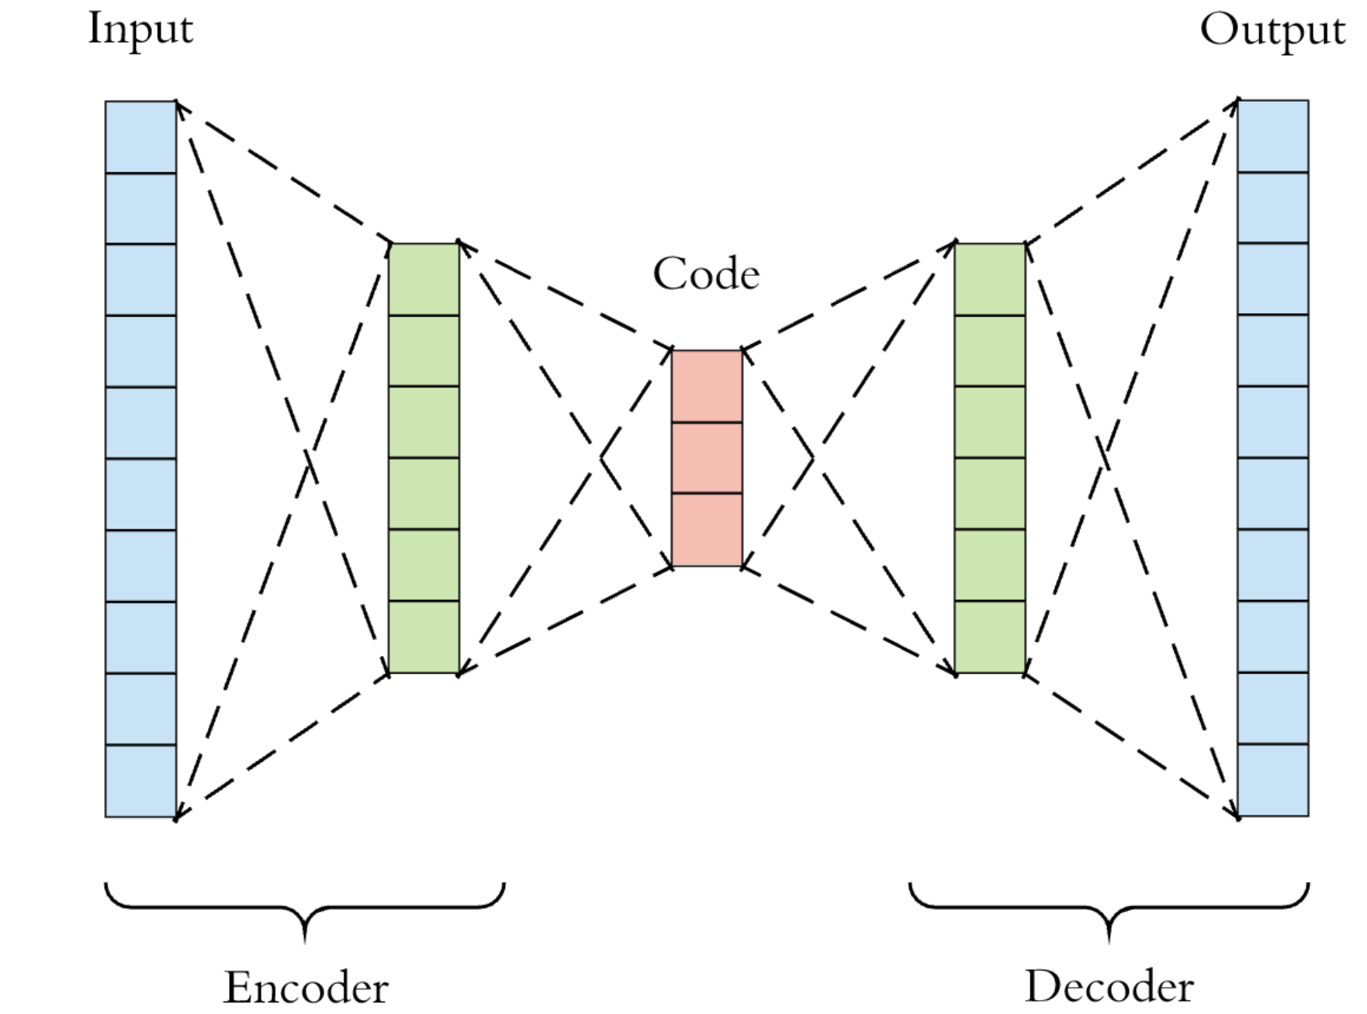
Methods model Summary – variational autoencoder
The VAE is based on an autoencoding framework, which can discover nonlinear explanatory features through data compression and nonlinear activation functions.
A traditional autoencoder consists of an encoding phase and a decoding phase where input data is projected into lower dimensions and then reconstructed.
An autoencoder is deterministic, and is trained by minimizing reconstruction error. In contrast, VAEs are stochastic and learn the distribution of explanatory features over samples.
VAEs achieve these properties by learning two distinct latent representations: a mean and standard deviation vector encoding.
The model adds a Kullback-Leibler (KL) divergence term to the reconstruction loss, which also regularizes weights through constraining the latent vectors to match a Gaussian distribution.

Slide 6
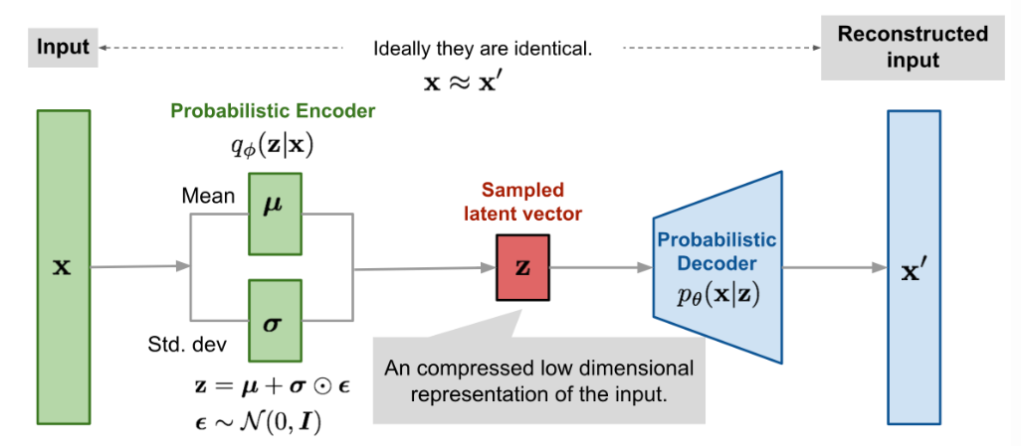
Diagram of variational autoencoder
The 5, 000 input genes (out of 20, 531) were selected based on the highest variability by median absolute deviation (MAD) in the TCGA pan-cancer dataset.
To facilitate training, the RNA-seq data was min-maxed scaled to the range of 0 − 1.
Tybalt was trained using an Adam optimizer. It included rectified linear units, batch normalization in the encoding stage, and sigmoid activation in the decoding stage.
It was observed that when batch normalization was included in the encoding step, tybalt trained faster and learned heterogeneous feature activations.

Slide 7
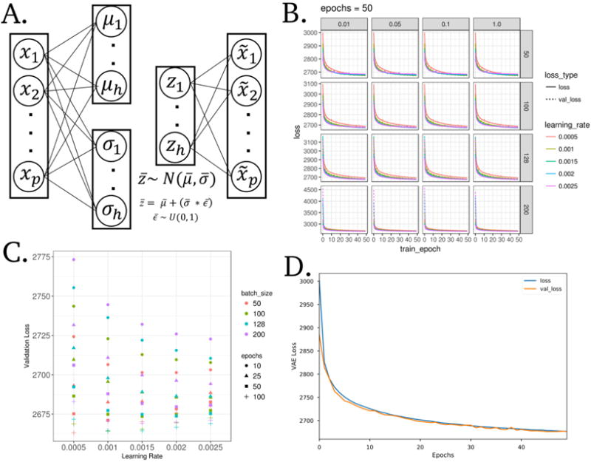
MODEL IMPLEMENTATION AND PARAMETER SELECTION
Model architecture of Tybalt: encodes a gene expression vector (p = 5,000) into mean (µ) and standard deviation (σ) vectors (h = 100). Then it is reconstructed back to the original.
Training and validation VAE loss across training epochs. The vertical and horizontal facets are values of κ (warmup) and batch size, respectively.
Final validation loss for all parameters with κ = 1.
VAE loss for training and testing sets through optimized model training.

Slide 8
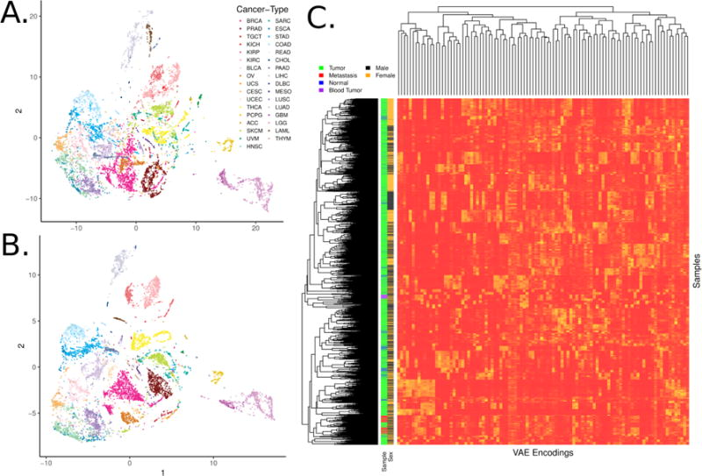
Samples encoded by a variational autoencoder retain biological signals
t-distributed stochastic neighbor embedding (t-SNE) of TCGA pan-cancer tumors with Tybalt encoded features.
t-SNE of 0-1 normalized gene expression features. Tybalt retains similar signals as compared to uncompressed gene expression data.
Full Tybalt encoding features by TCGA pan-cancer sample heatmap. Given on the y axis are the patients sex and type of sample. Based on the hierarchical clustering dendrogram, the tissue-specific signal was captured by non-redundant, and highly heterogenous features.

Slide 9
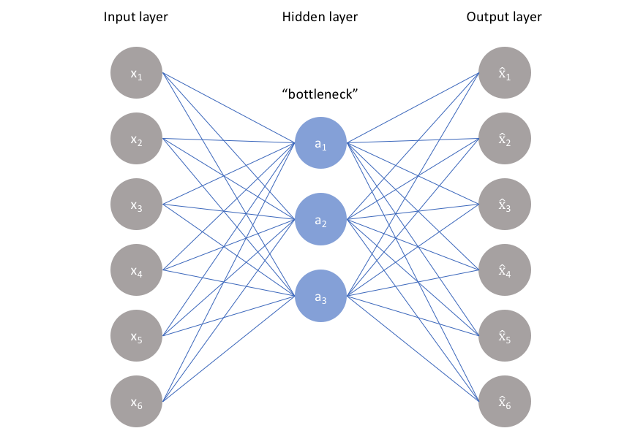
Interpreting Biological features from tybalt
Interpretation of biological signals is performed in the following ways, i.e., by using,
the learned encodings.
the decoder weights capture the contribution of specific genes to each learned encoding.
over-representation pathway analysis on the high-weight genes to determine significant pathways promoting different biological signals.
the generated latent space.
They investigate whether or not Tybalt could distinguish patient sex and patterns of metastatic activation in skin cutaneous melanoma tumors using the first three methods.

Slide 10
Interpreting Biological features from tybalt
They experimented whether or not Tybalt learned manifold differences of distinct high grade serous ovarian cancer (HGSC) subtypes.
Previously, several groups identified four HGSC subtypes using gene expression. However, the four HGSC subtypes were not consistently defined across populations; the data suggested the presence of three subtypes or fewer.
The previous study observed that the immunoreactive/mesenchymal and differentiated/proliferative tumors consistently collapsed together when setting clustering algorithms to find 2 subtypes.
This observation may suggest the presence of distinct gene expression programs existing on an activation spectrum driving differences in these subtypes.
Therefore, we hypothesized that Tybalt would learn a latent space which could stratify the HGSC subtypes.

Slide 11
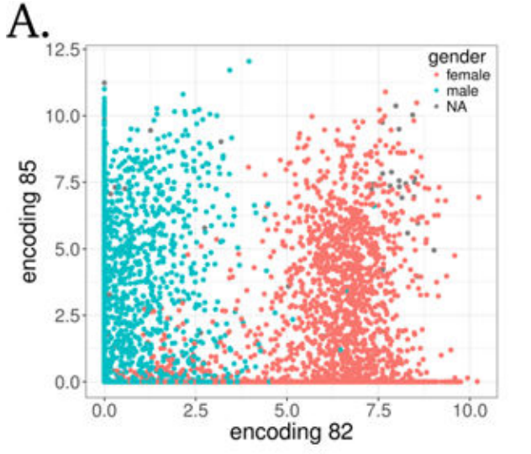
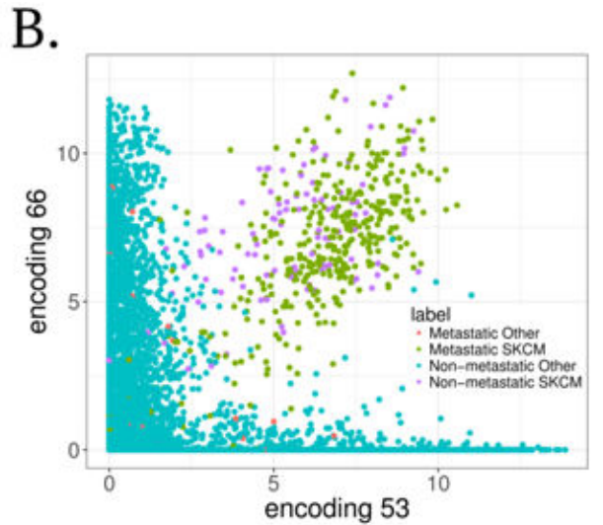
ENCODINGS represent biological signal
(A) Encoding 82 stratified patient sex.
Feature encoding 82 nearly perfectly separated samples by sex.
(B) Encodings 53 and 66 separated melanoma tumors.
The Tybalt identified a set of nodes that together identified skin cutaneous melanoma (SKCM) tumors of both primary and metastatic origin.

Slide 12
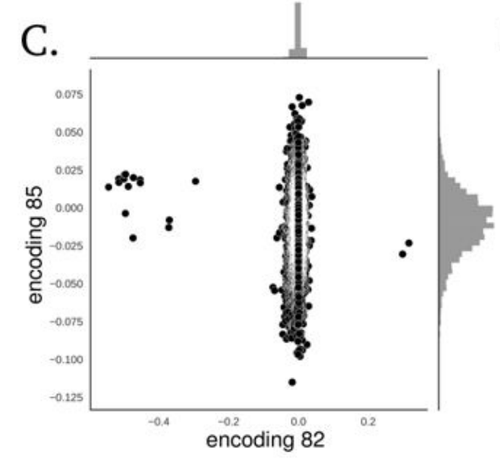
Gene weights represent biological signal
The weights used to decode the hidden layer (z vector) can capture important and consistent biological patterns embedded in the gene expression data.
17 genes needed to identify patient sex.
These genes were mostly located on sex chromosomes.
The two positive weight genes were X inactivation genes XIST and TSIX, while the negative weight genes were mostly Y chromosome genes such as EIF1AY, UTY, and KDM5D.
This results served as positive control that unsupervised model was able to construct a feature that described a clearly biological source of variance in the data.
(C) Distributions of gene coefficients contributing to each plot above for patient sex.

Slide 13
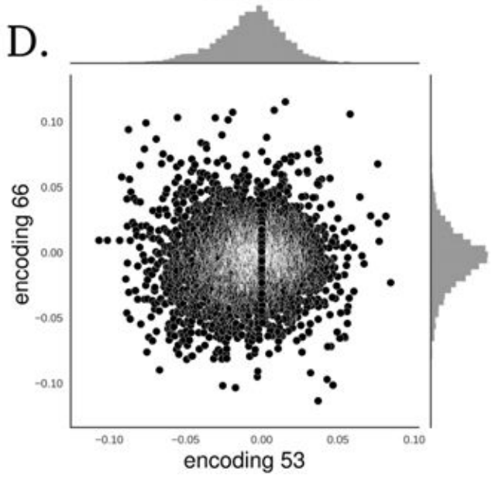
Gene weights represent biological signal
There were several genes contributing to the two encoded features that separated the SKCM tumors.
Most of these genes existed in the high weight tails of each distribution for feature encodings 53 and 66.
Next, using the significant genes (high-weight), they performed ORA analysis.
(D) Distributions of gene coefficients contributing to each plot above for melanoma.

Slide 14
Over-Representation Analysis and go term
(A) Over-Representation Analysis: it measures the percentage of genes in a pathway or any gene ontology (GO) groups.
It is a widely used approach to determine whether known biological functions or processes are over-represented in an experimentally-derived gene list
(B) Gene Ontology (GO): describes our knowledge of the biological domain with respect to three aspects:
Molecular Function: Molecular-level activities performed by gene products. Molecular function terms describe activities that occur at the molecular level, such as “catalysis” or “transport”.
Cellular Component: The locations relative to cellular structures in which a gene product performs a function.
Biological Process: The larger processes, or ‘biological programs’ accomplished by multiple molecular activities. Examples of broad biological process terms are DNA repair or signal transduction.
(C) WebGestalt: tool is used of ORA and GO term analysis.
Notes:
Based on this they found that
feature encoding 53, which did not correspond to any known GO term, potentially indicating an unknown but important biological process.
encoding 66 which implicated GO terms related to cholesterol, ethanol, and lipid metabolism including regulation of intestinal cholesterol absorption , ethanol oxidation ,and lipid catabolic process.

Slide 15
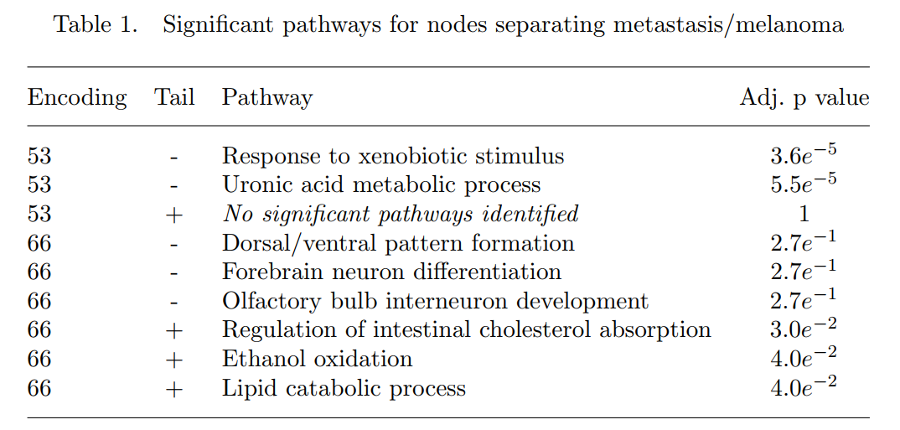
Over-Representation Analysis for SKCM tumor Encodings
They performed an over-representation pathway analysis on the high weight genes of encoding 53 and 66.
Several pathways were identified as over-represented in the set as compared to random.
The samples had intermediate to high levels of feature encoding 53, which did not correspond to any known GO term, potentially indicating an unknown but important biological process.
The samples also had intermediate to high levels of encoding 66 which implicated GO terms related to cholesterol, ethanol, and lipid metabolism.
The SKCM samples had consistently high activation of both encoded features, which separated them from other tumors.

Slide 16
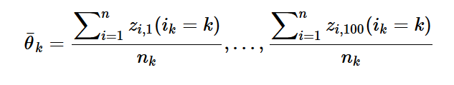


Interpolating the lower dimensional manifold of HGSC subtypes
They performed an experiment to test whether or not Tybalt learned manifold differences of distinct HGSC subtypes.
If Tybalt learned a biological manifold, this subtraction would result in the identification of biologically relevant features stratifying tumors of specific subtypes with a continuum of expression states.
Notes:
IDENTIFIED ENCODING WITH HIGHEST DIFFERNCE OUT OF 100 POSSIBILITIES.
-edit TEXT/ EXPLAIN FORMULA

Slide 17
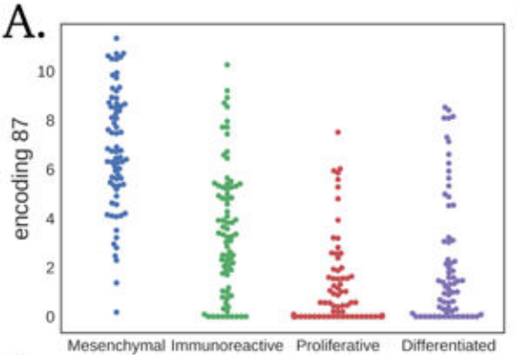
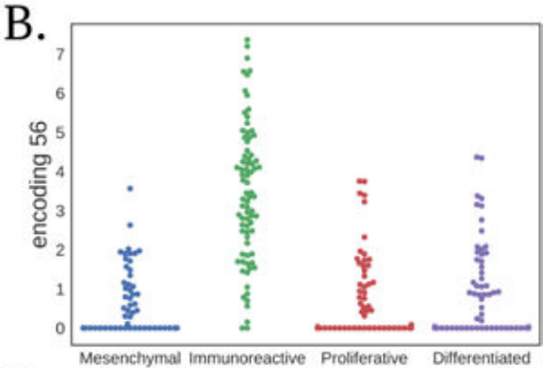
Interpolating the lower dimensional manifold of HGSC subtypes
The largest feature encoding difference between the mean HGSC mesenchymal and the mean immunoreactive subtype was encoding 87.
Encoding 87 and encoding 56 distinguished the mesenchymal and immunoreactive subtypes.
Notes:
PLOTTED ALL POINTS .

Slide 18
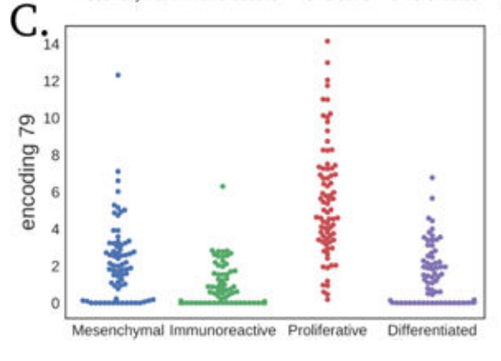
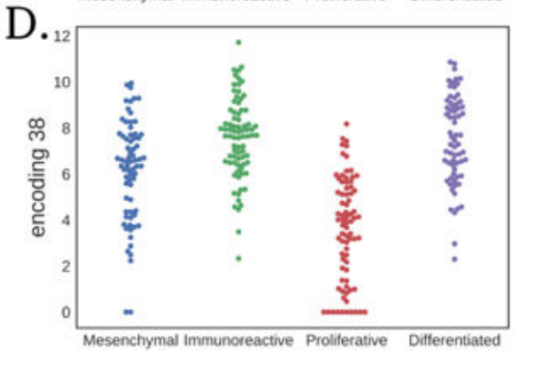
Interpolating the lower dimensional manifold of HGSC subtypes
The largest feature encoding differences between the mean proliferative and the mean differentiated subtype were contributed by encoding 79 and encoding 38.
Interestingly, encoding 38 had high mean activation in both the immunoreactive and differentiated subtypes.

Slide 19
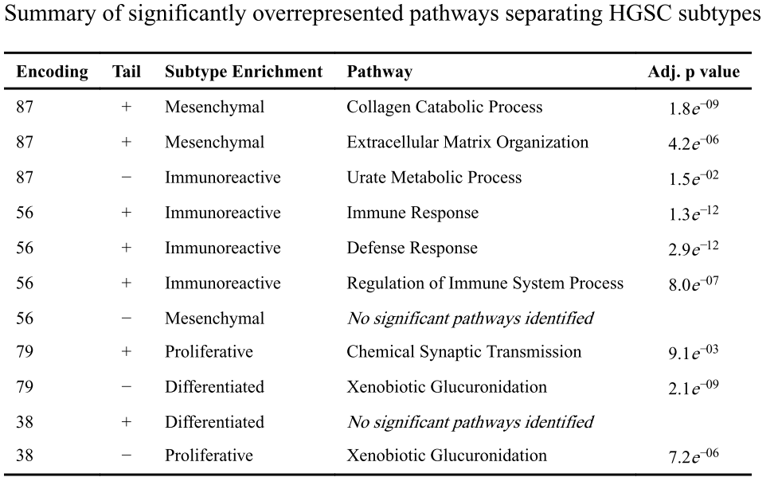
Interpolating the lower dimensional manifold of HGSC subtypes
Encoding 87 was associated with the expression of genes involved in collagen and extracellular matrix processes.
Encoding 56 was associated with immune system responses, and the immunoreactive subtype displayed the highest activation.
Encoding 79 is mostly expressed in the proliferative subtype and has low activation in differentiated tumors.
The negative genes of encoding 38, which also distinguished differentiated from proliferative tumors but in the opposite direction, were also associated with glucuronidation.

Slide 20
Conclusion
They observed that the encoded features recapitulated tissue specific patterns
The learned features were generally non-redundant and could disentangle large sources of variation in the data, including patient sex and SKCM.
Interpretation of the decoding layer weights helped to identify the contribution of different genes and using ORA, pathways promoting disparate biological patterns were indentified.
VAEs provide similar benefits as autoencoders, but they also have the ability to learn a latent space with meaningful biological relationships.
This latent space could represent differing pathway activations, transitions between cancer states, or indicate particular tumors vulnerable to specific drugs.
This effort will lead to widespread stratification of expression patterns and enable accurate detection of samples who may benefit from specific targeted therapies.
Further testing is required to confirm that Tybalt catalogued an interpretable manifold capable of interpolation between cancer states.
Notes:
.[AS SEEN IN T-SNE]
AND HC DENDOGRAM]
[as seen in hgsc]
[just mention how tybalt is just a technique… interpretations requires more research. Also, they plan to build better models and better interpretation [JUST SAY THIS AT END]

Slide 21
Thank you

